Slide 1
accident-prone | accountancy | apparent | audible | care
accommodate | align | appreciate | available | beneficial
accompany | amateur | assign | bare | best-known
Sound association
Let’s look at our sound associations for each word.

Slide 2
bible | bomb | bowled | climb | commercial
border | boarder | buffer | collectable | community
bold | borough | category | comb | compatible
Phonemes
Let’s look at each of the words and break them into phonemes (units of sound).
The dots show 1 sound represented by 1 letter ( 1 grapheme).
The dashes show 1 sound represented by 2 letters (digraph).
b or d er

Slide 3
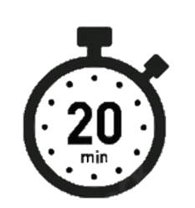
Word workout Write our next lot of spelling words in the back of your spelling books. Can you add the dots and dashes?
compliancy | conceitedly | constructible | convertible | crucial
comprehensible | conscience | controversy | correspond | crumb
computer-aided | conscious | convenience | criticise | dept

