Slide 1
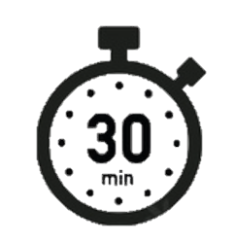
Spell it out
infectious | knife | legible | non-smoker | non-stop
influential | knight | luscious | non-starter | noticeable
island | lamb | non-drip | non-stick | naughty
Day 1

Slide 2
Spell it out
observant | official | preferred | referral | rough
occupant | ought | preferring | referred | scrumptious
occupancy | partial | pretentious | referring | sensible
Day 1

Slide 3
Spell it out
sensible | thistle | torrential | transferring | absent
spacious | thought | tough | well-known | accent
special | tolerant | transferred | absence | affect
Day 1

