Slide 1
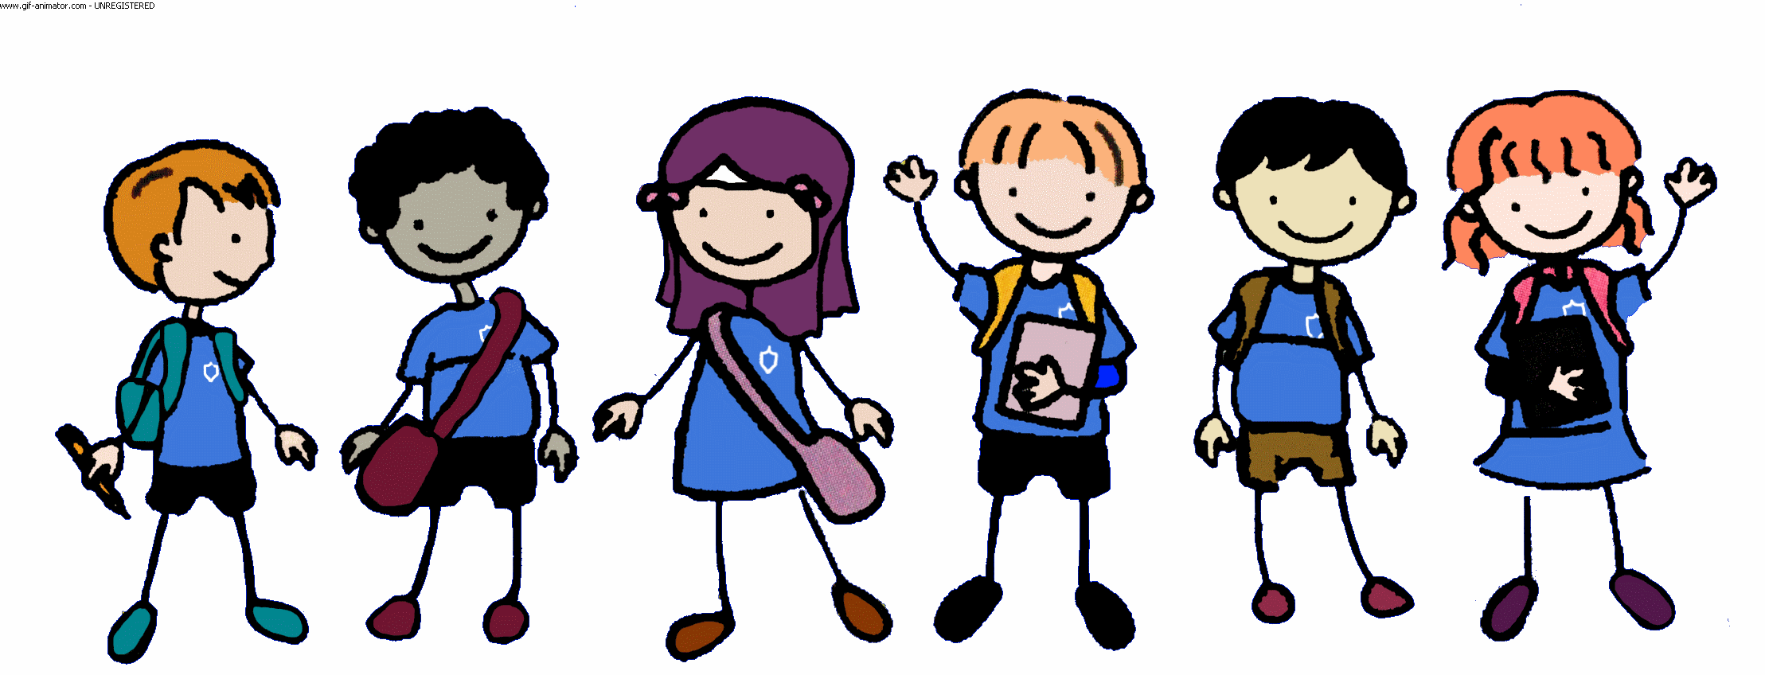
Welcome to Year 3/4 A

Slide 2
Today we will be looking at:
Reading Fluency
Multiplication

Slide 3
Reading Fluency
Reading fluency is important because it develops comprehension and motivates readers.
Reading fluency is the ability to read with proper speed, accuracy, and expression. Children must be able to read fluently to understand what they’re reading. This applies to both silent reading and reading out loud.
When doing the latter, fluent readers can read phrases and add in proper intonation when needed. As a result, reading becomes smooth and expressive.
This is what we’re going to practise now ☺
Number yourselves No.1 and No. 2

Slide 4
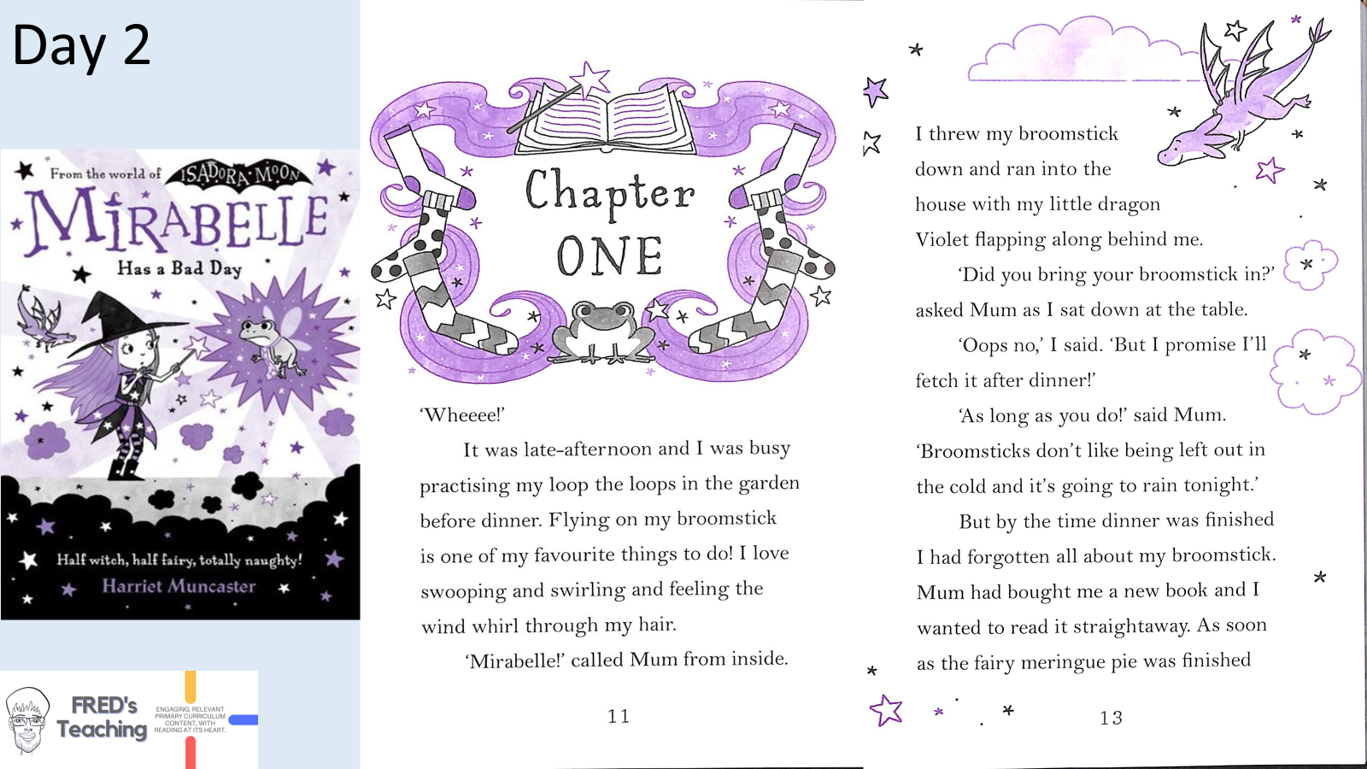

Slide 5
Late afternoon
Flying on her broomstick
Violet
move (its wings) up and down when flying
or preparing to fly
to tell someone that you will
certainly do something

Slide 6
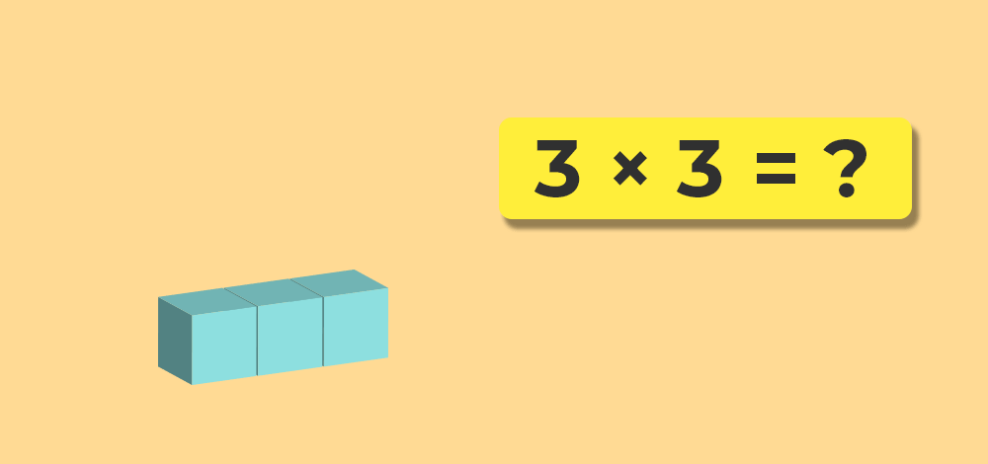
Multiplication
The ‘Building Blocks’ of Maths
By learning smaller times tables and gradually building up, children will learn number rules that’ll make learning other tables much easier.
For example, once you know your 2 times table, you can learn your 4 times table simply by doubling the answers!
Then, you can double your 4s to learn your 8s.
Let’s have a go…

Slide 7
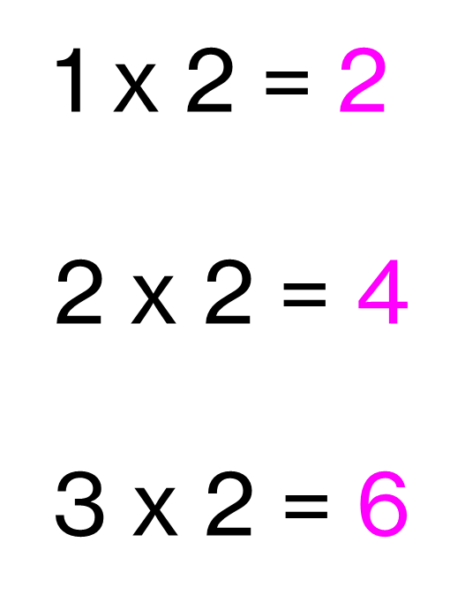
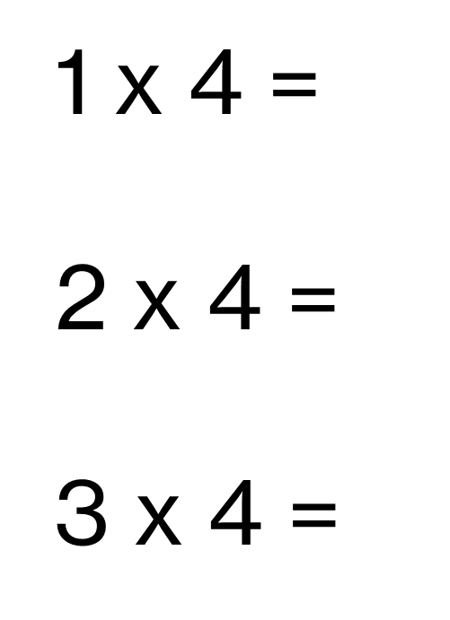
x2 -----→ Double x4 ----→ Double x8
1 x 8 =
2 x 8 =
3 x 8 =

Slide 8
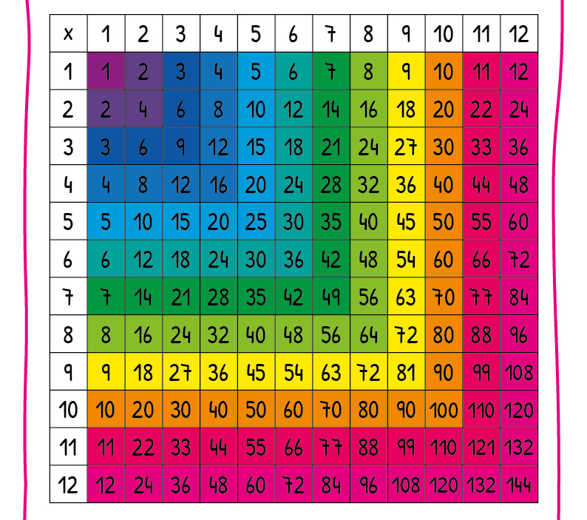
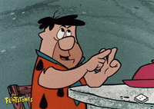
Memorising times tables makes it far quicker and easier for us to work out maths problems in our heads, Moving beyond using fingers to work out answers and quickly solve any multiplication questions

Slide 9
The multiplication tables check (MTC) is statutory for all year 4 pupils registered at state-funded maintained schools, special schools or academies, including free schools, in England.
The purpose of the MTC is to determine whether pupils can recall their times tables fluently, which is essential for future success in mathematics.
Let’s practise our recall… ☺
KIRFS TTROCKSTARS Times Table check online
Daily 10 (Topmarks.co.uk)

Slide 10
When we move on to larger multiplication Qs, we need to use taught strategies that we are confident with to help us ☺
T-Time
How would you solve this calculation?
23 x 3 =

Slide 11
23 x 3 =
Using your place value counters, make
3 lots of 23
Can you draw place value counters showing 3 lots of 23
2 3
2 3
+ 2 3
2 3
x 3

Slide 12
17 x 3 =
Using your place value counters, make
3 lots of 17
Can you draw place value counters showing 3 lots of 17
1 7
1 7
+ 1 7
1 7
x 3

Slide 13
Let’s play Bingo!
In your grid, please choose and write in 6 multiples of 3.
0 3 6 9 12 15 18 21 24 27 30 33 36 39

Slide 14
☺ Please take a look through your child’s books ☺

