Slide 1
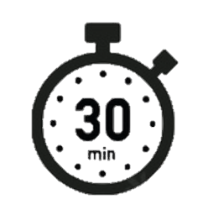
Spell it out
attached | bargain | bruise | cemetery | communicate
average | bought | committee | changeable | competition
awkward | brought | cautious | circumstantial | conceive
Day 1

